Slide 1
SOFTWARE REENGINEERING
1

Slide 2
Lecture Summary
Lehman’s Laws of Evolution

Slide 3
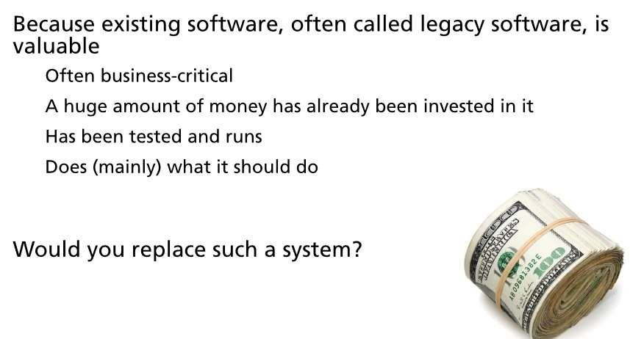
Why non-greenfield engineering?
6
Notes:
A legacy system is outdated computing software and/or hardware that is still in use. The system still meets the needs it was originally designed for, but doesn't allow for growth

Slide 4
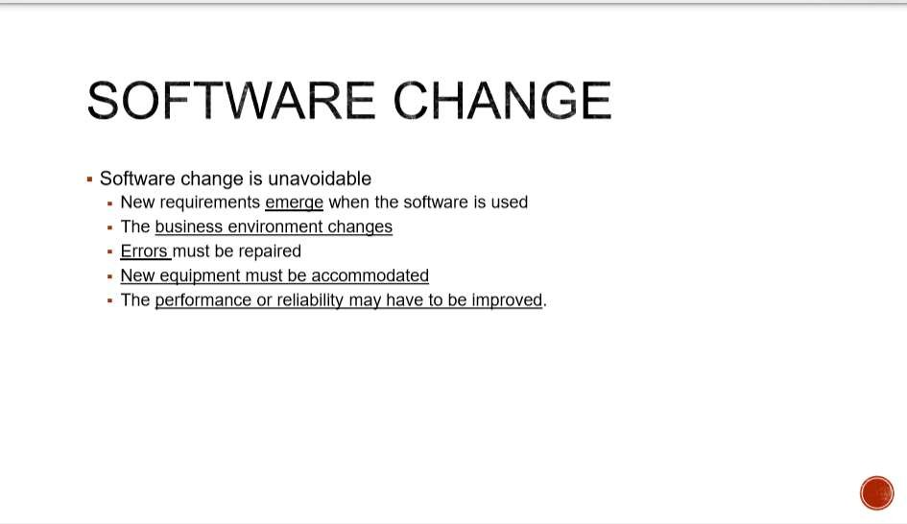
8

Slide 5
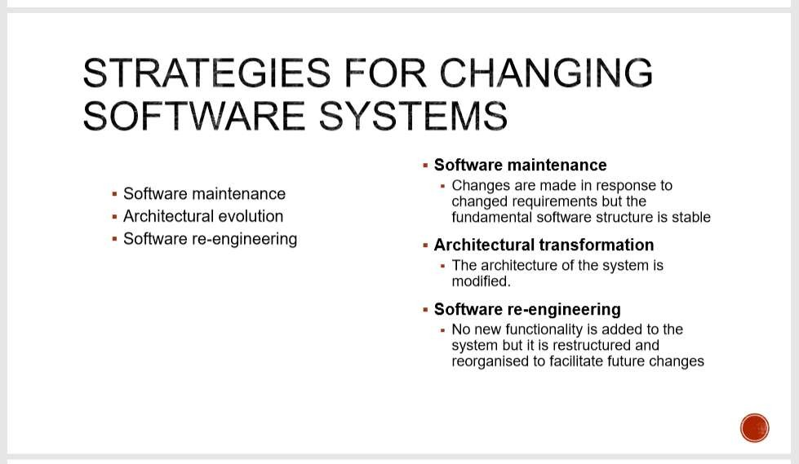
9

Slide 6
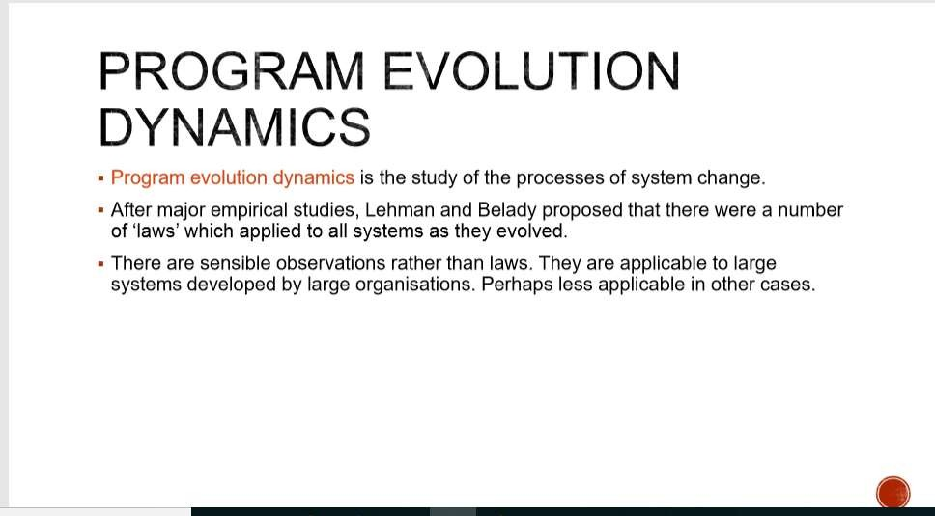
11

Slide 7
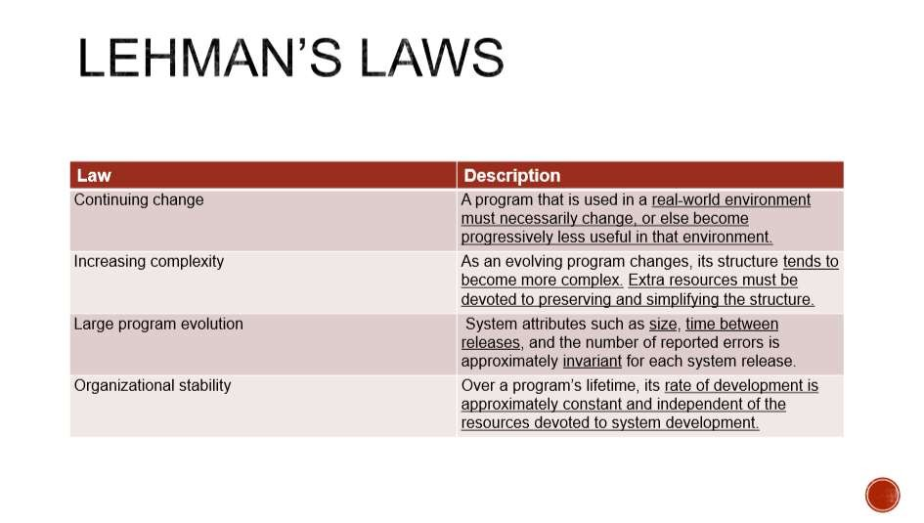
12

Slide 8
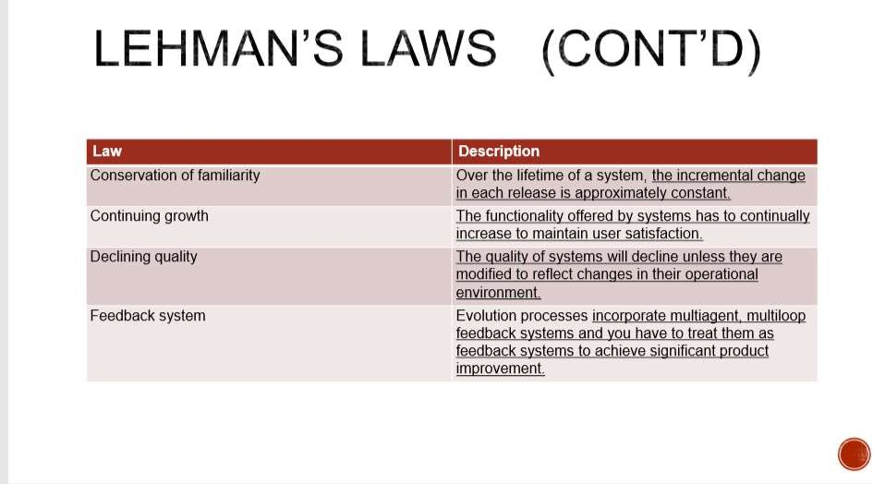
13

Slide 9
Legacy Systems: Introduction..
Legacy systems: old computer-based systems still in use by organizations
Many of them still business critical
Incorporate many changes made over the years
Many people have been involved in these changes
Replacing legacy systems with new systems is risky, yet keeping them means new changes become more and more expensive

Slide 10
Legacy Systems: .Introduction.
Risks of replacing a legacy system:
Specification is difficult because existing documentation is typically incomplete
Changing business processes may require high costs.
Undocumented, yet important business rules may be embedded in the system; a new system may break these rules
The new system may be delivered late, may cost more than expected, and may not function properly

Slide 11
Legacy Systems: ..Introduction
Factors that make changes to legacy systems expensive:
In large systems, different parts were implemented by different teams, without consistent programming style
It is difficult to find personnel who knows the obsolete programming languages used in old systems
In many cases the only documentation is provided by the source code; even this may be missing
Data used by the system is difficult to understand and manipulate; it can also be obsolete and/or redundant

Slide 12
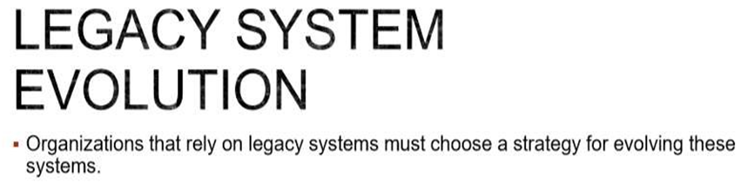
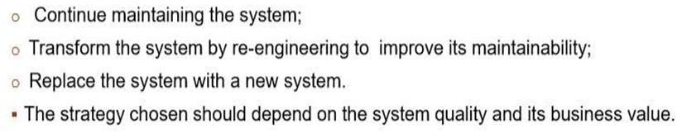
17

Slide 13
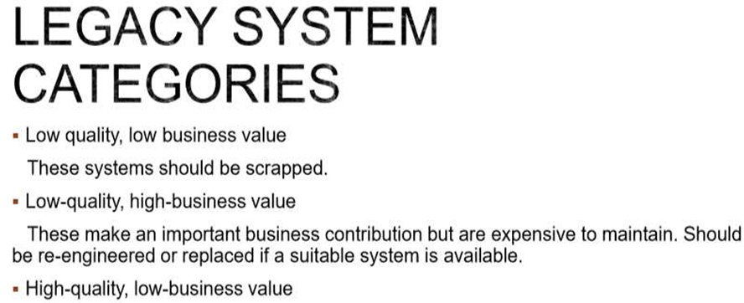

18

Slide 14
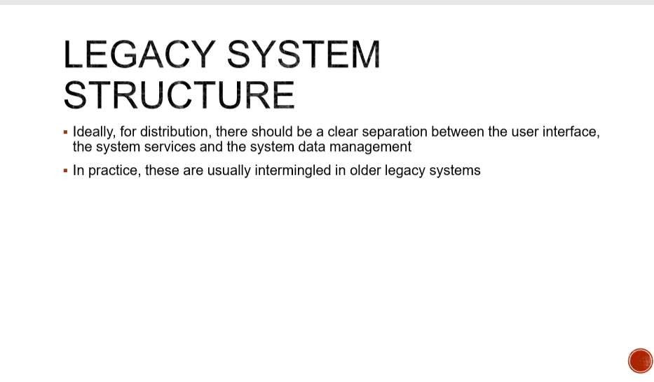
19

Slide 15
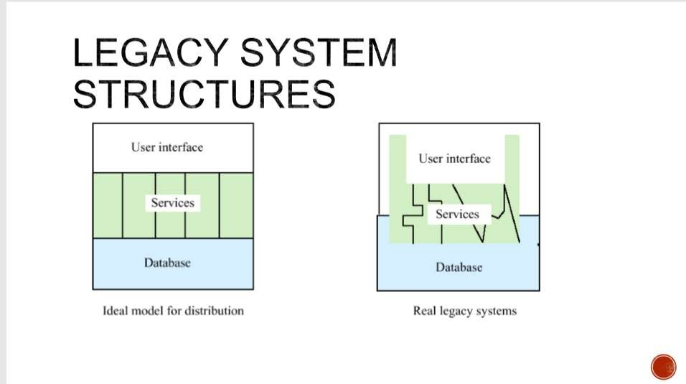
20

Slide 16
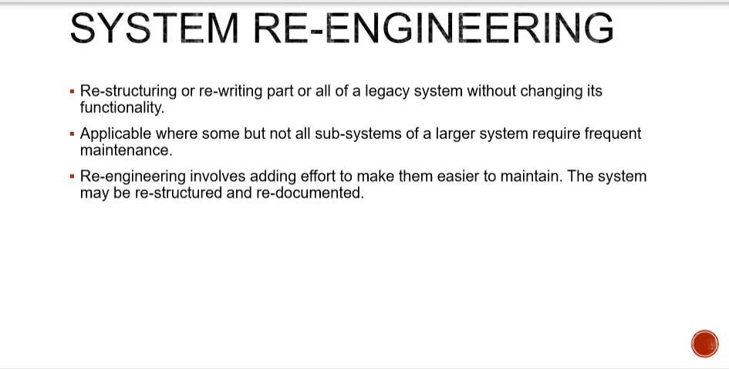
22

Slide 17
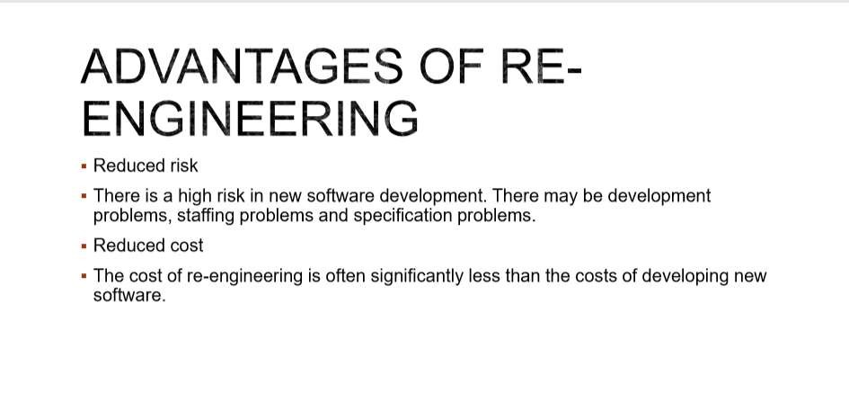
23

Slide 18
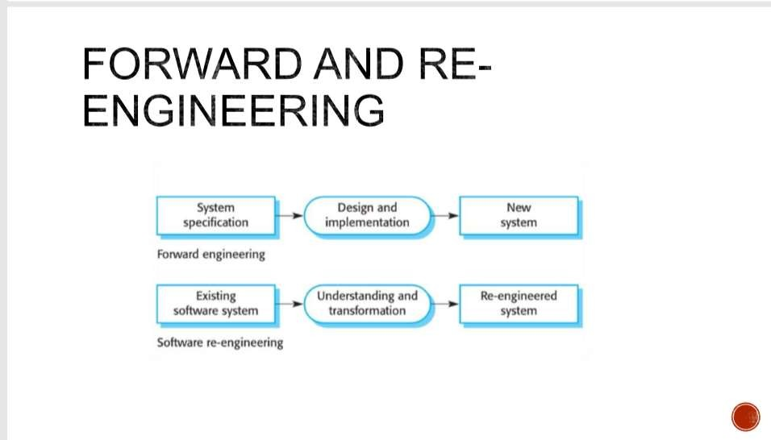
24

Slide 19
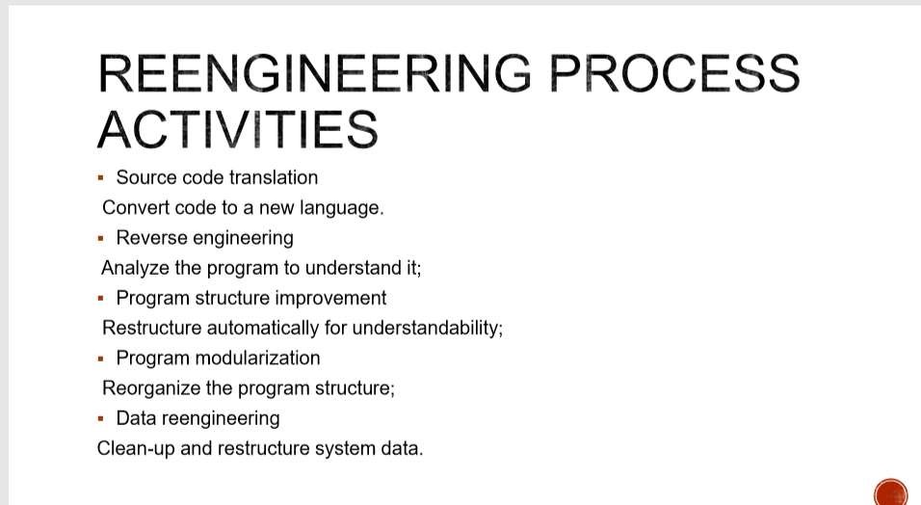
25

Slide 20
Legacy system assessment…..
Strategic approaches for dealing with legacy systems:
Scrap the system completely
When business practices have changed and no longer depend significantly on the system
Continue to maintain the system
The system works well, is fairly stable, and users do not request many changes

Slide 21
Legacy system assessment…..
Strategic approaches for dealing with legacy systems:
Transform the system to improve maintainability
When system quality was affected negatively by changes, yet changes are still required
Replace the system with a new one
When outmoded hardware prevents further operations

Slide 22
Legacy system assessment…
 Assessment of legacy systems includes:
(1) Business value assessment
Viewpoints:
End-users: look at system’s functionality and performance
Customers: look at the quality of services provided
Business managers: assess the usefulness of the system in terms of business support

Slide 23
Legacy system assessment
 Assessment of legacy systems includes:
(1) Business value assessment
Viewpoints:
IT managers: are concerned with the availability of technical support for the system
Senior managers: interested in system’s contribution to the business goals

Slide 24
Legacy system assessment
System quality assessment. Look at all components of the
system. Hence:
Environment assessment. Support software & hardware platform (maintenance costs, faults, etc. )
Application software assessment.
Number of system change requests
Number of different user interfaces
Volume of data used by the system

Slide 25
….Legacy system assessment.
 Factors in environment assessment
Factor Questions
Supplier stability
Is the supplier is still in existence? Is the supplier financially stable and likely to continue in existence? If the supplier is no longer in business, are the systems maintained by someone else?
Failure rate
Does the hardware have a high rate of reported failures? Does the support software crash and force system restarts?
Age
How old is the hardware and software? The older the hardware and support software, the more obsolete it will be. It may still function correctly but there could be significant economic and business benefits to moving to more modern systems.
Performance
Is the performance of the system adequate? Do performance problems have a significant effect on system users?
Support requirements
What local support is required by the hardware and software? If there are high costs associated with this support, it may be worth considering system replacement.
Maintenance costs
What are the costs of hardware maintenance and support software licences? Older hardware may have higher maintenance costs than modern systems. Support software may have high annual licensing costs.
Interoperability
Are there problems interfacing the system to other systems? Can compilers etc. be used with current versions of the operating system?

Slide 26
…..Legacy system assessment
 Factors in application software assessment [Fig. 21.15 SE-8]
Factor
Questions
Understandability
How difficult is it to understand thesource code of the current system? Do variables have meaningful names that reflect their function?
Documentation
What system documentation is available? Is the documentation complete, consistent and up-to-date?
Is there an clear data model for the system? Towhat extent is data
Data
duplicated in different files? Is the data used by thesystem up-to-date and consistent?
Performance
Is the performance of the application adequate? Do performance problems havea significant effect onsystem users?
Programming language
Are modern compilers available for the programming language used to develop the system? Is the programming language still used for new system development?
Configuration management
Are all versions of all parts of the system managed bya configuration management system? Is there an explicit description of the versions of components that are used in thecurrent system?
Test data
Does test data for the system exist? Is there a record of regression tests
carried out when newfeatures have been addedto thesystem?
Personnelskills
Are there people available who havethe skills to maintain the application? Are there only a limited number of people who understand the system?

